Slide 1
Software Engineering and Architecture
Software Configuration Management (SCM)
Motivation

Slide 2
Motivation: Collaboration
SCM helps to solve two very nasty problems in dev
  Team collaboration on large code bases
  Releasing large code bases to customers
War stories from my dark past in the mid 1990’ies
  SAWOS ‘collaboration’ on 150.000 lines of C++ code
    Each developer had a copy ☹☹☹
    All source files on central file server ☹☹☹
      Inverted race problem – save last, for god’s sake!
    Manual locking ☹☹☹
      Thumbtacks in colors on each filename on whiteboard
    Daily Split-Merge cycle ☹
      Split in morning – merge manually in afternoon
Notes:
Windows XP was 40 million LOC

Slide 3
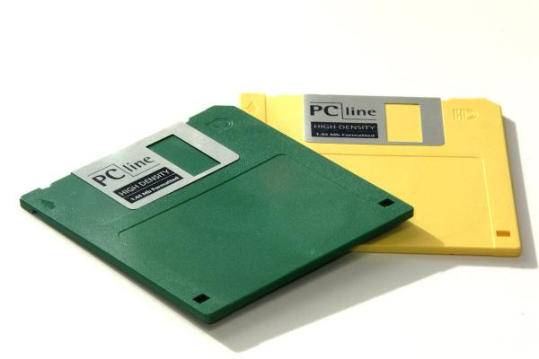
Motivation: Release
SAWOS release management
  We made a full copy as ZIP file, copied that to a diskette, marked with revision number and date, and put into the company safe.
  (This actually worked quite well!)
And used ‘son-father-grandfather’ backup strategy

Slide 4
Motivation
So – we were idiots or what?
Not quite
  I worked in 1992 in Horsens
  CVS was published in 1991 – first commonly used SCM tool
    And our 20-person company in Horsens did not read papers
  No internet to search!
    Question? Send fax to MicroSoft in Stockholm and never get answer
  No SCM teaching at university at all!

Slide 5
SCM in 2½ Slides
Read the book
or
Watch the Screencasts

Slide 6
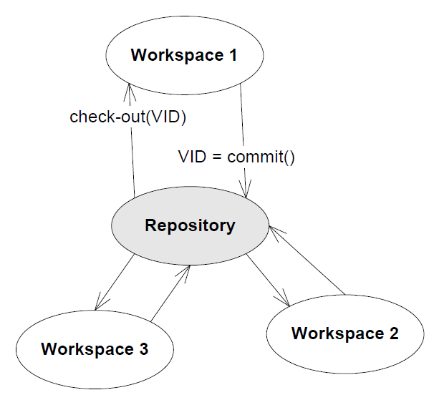
SCM Versioning
Repository = Database
  Stores all versions of all your code
Workspace = Folder structure
  Each developer do daily TDD there
Operations
  Commit (check-in)
    Store new version of everything/snapshot
  Check-out
    Retrieve specific version
    Release management = Get copy of what is running at costumer

Slide 7
Git…
Git’s model is more complex ☹
  Repositories form a chain (workspace -> local -> Origin)
Git commit –a –m “log msg”
  Check-in into local repository
    Stored on my local harddisk
Git push
  Copy version to origin repository
    In our case, AU GitLab
Git pull
  Copy version from origin to
  local and workspace
Local Repo
Local Repo
Local Repo

Slide 8
Git…
So – to collaborate, Arne and Bente
Arne does work on HotStone on his computer (workspace)
Arne then commits and pushes
  The push is important! Otherwise
  the new version is only on
  Arne’s computer
Bente then pulls
  … to get Arne’s work into her
  own workspace
Local Repo
Local Repo
Local Repo

Slide 9
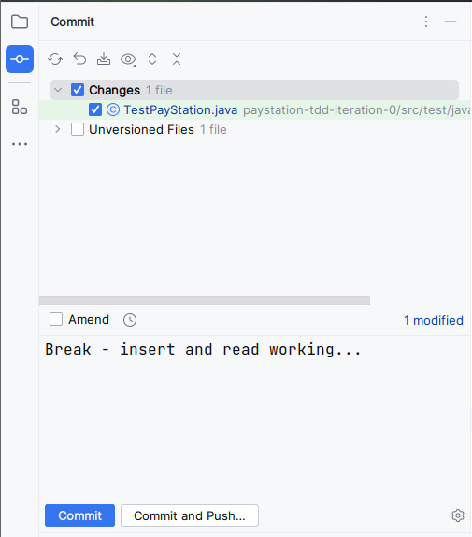
Or… In IDE
Click to set the
‘staging area’
Enter log message
Commit
  And push!

Slide 10
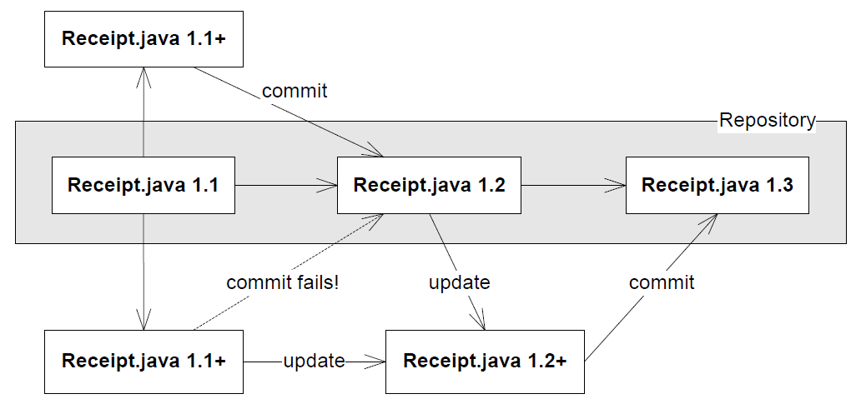
SCM Collaboration
Arne
Bente
Merging both Arne and Bente
work

